Slide 1

Chapter 1 Investment Setting
LO 1. Demonstrate a comprehensive understanding of the theories and characteristics associated with securities valuation and investment portfolio management.
Course Facilitator
Dr. Linh Ho - Examiner

Slide 2
Outline
What is an Investment
Measures of Return and Risk
Measures of Return
Historical Rate of Return
Expected Rate of Return
Measures of Risk
Risk for Historical Rate of Return
Risk for Expected Rate of Return
Determinants of Required Rate of Return
Relationship between Risk and Return
Notes:
Market efficiency
Do the returns of international ETFs follow a random walk?
Is the calendar effect present in the returns of International ETFs?
Performance dynamics
Is there any difference in the returns and return volatilities measured in trading prices and NAVs of International ETFs?
Is there any difference in the return volatilities during trading (intraday) and non-trading (overnight) hours of International ETFs?
Are International ETFs suffer with any tracking error, if yes, is it persistent over time? and
Are International ETFs closely trade to their net asset value (NAV) and does the pricing inefficiency (if any) persist over time?

Slide 3
What is an investment?
1

Slide 4
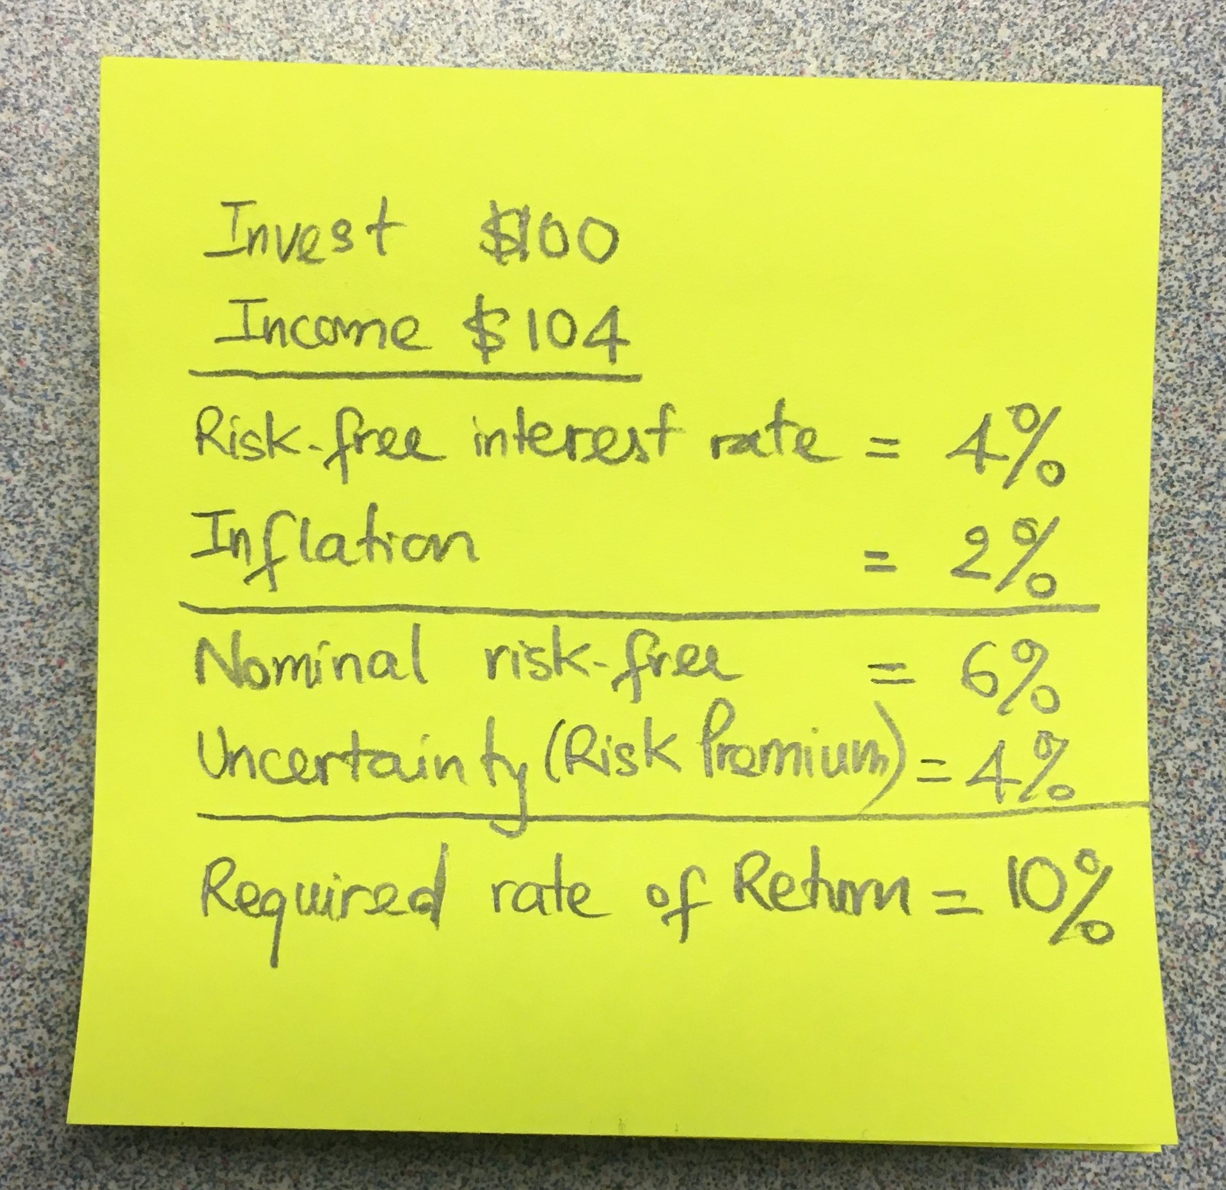
What is an Investment?
Investment is the current commitment of dollars for a period of time in order to derive future payments that will compensate the investor for;
The time the funds are committed
Expected rate of inflation during this time period, and
The uncertainty of the future payments.

Slide 5
Measures of Return and Risk
2

Slide 6
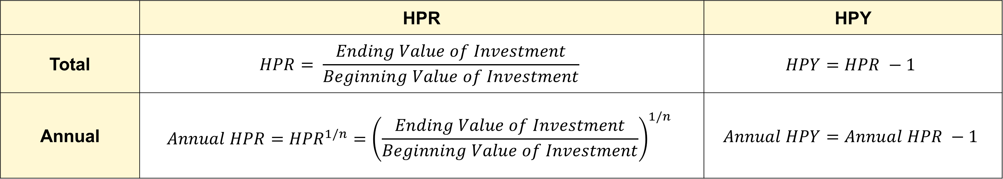
Historical Rates of Return
 | HPR | HPY
Total | $$HPR= \frac{Ending Value of Investment}{Beginning Value of Investment}$$ | $$HPY=HPR −1$$
Annual | $$Annual HPR={HPR}^{1/n}={\left(\frac{Ending Value of Investment}{Beginning Value of Investment}\right)}^{1/n}$$ | $$Annual HPY=Annual HPR −1$$
Holding Period Return (HPR)
HPR is the total return for a particular holding period.
HPR ranges from zero or greater
HPR > 1 means positive returns
HPR < 1 means negative returns
Holding Period Yield (HPY)
HPY is percentage return for a particular holding period
HPY can be negative or positive
HPY > 0 means positive returns
HPR < 0 means negative returns

Slide 7

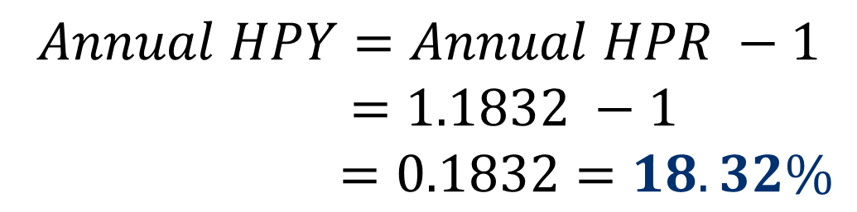
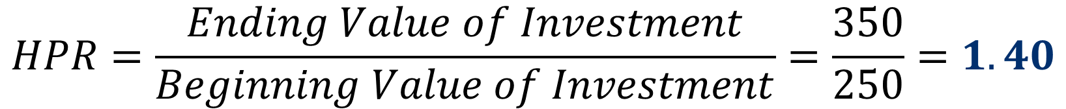
Examples: when the wealth INCREASES at the end of the holding period
Hand-on activities
Example 1 (Single-Period): Assume that you invest $200 at the beginning of the year and get back $220 at the end of the year. What are the HPR and the HPY for your investment?
Solution:
Example 2 (Multi-Period): Consider an investment that cost $250 and is worth $350 after being held for two years. What are the annual HPR and annual HPY for your investment?
Solution:
$$HPR=\frac{Ending Value of Investment}{Beginning Value of Investment}=\frac{220}{200}=1.10$$
$$HPR=\frac{Ending Value of Investment}{Beginning Value of Investment}=\frac{350}{250}=1.40$$
$$HPY=HPR −1=1.10 −1=0.10=10\%$$
$$Annual HPR={HPR}^{1/n}={\left(1.40\right)}^{1/2}=1.1832$$
$$Annual HPY=Annual HPR −1$$
$$=1.1832 −1$$
$$=0.1832=18.32\%$$

Slide 8
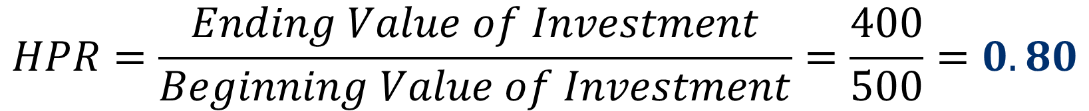

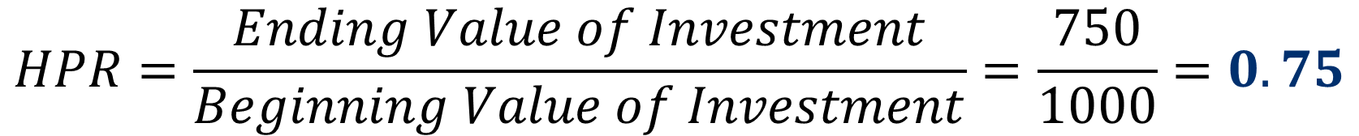
Examples: when the wealth DECREASES at the end of holding period
Hand-on activities
Example 3 (Single-Period): Assume that you invest $500 at the beginning of the year and get back $400 at the end of the year. What are the HPR and the HPY for your investment?
Solution:
Example 4 (Multi-Period): Consider an investment that cost $1000 and is worth $750 after being held for two years. What are the annual HPR and annual HPY for your investment?
Solution:
$$HPR=\frac{Ending Value of Investment}{Beginning Value of Investment}=\frac{400}{500}=0.80$$
$$HPR=\frac{Ending Value of Investment}{Beginning Value of Investment}=\frac{750}{1000}=0.75$$
$$HPY=HPR −1=0.80 −1=−0.20=−20\%$$
$$Annual HPR={HPR}^{1/n}={\left(0.75\right)}^{1/2}=0.866$$
$$Annual HPY=Annual HPR −1$$
$$=0.866 −1$$
$$=−0.134=−13.4\%$$

Slide 9
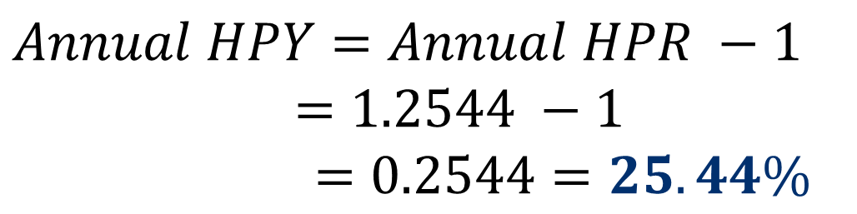
Example 5: when holding period is less than a year
Hand-on activities
Consider an investment of $100 held for only six months that earned a return of $12. What are the annual HPR and annual HPY for your investment?
Solution:
$$HPR=\frac{Ending Value of Investment}{Beginning Value of Investment}=\frac{112}{100}=1.12 (n=0.5)$$
$$Annual HPR={HPR}^{1/n}={\left(1.12\right)}^{1/0.5}=1.2544$$
$$Annual HPY=Annual HPR −1$$
$$=1.2544 −1$$
$$=0.2544=25.44\%$$

Slide 10
STOP and THINK
In which scenarios, Total HPR = Annual HPR?
In which scenarios, Total HPY = Annual HPY?

Slide 11
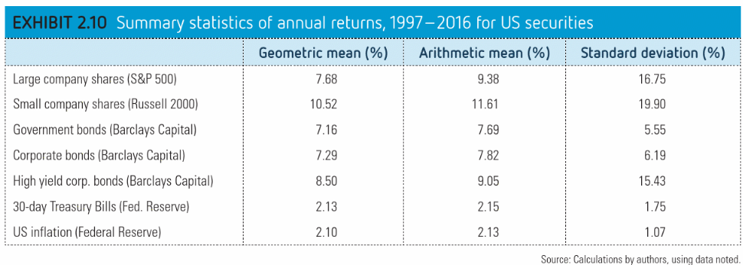
Explain the statistics in the table below

Slide 12
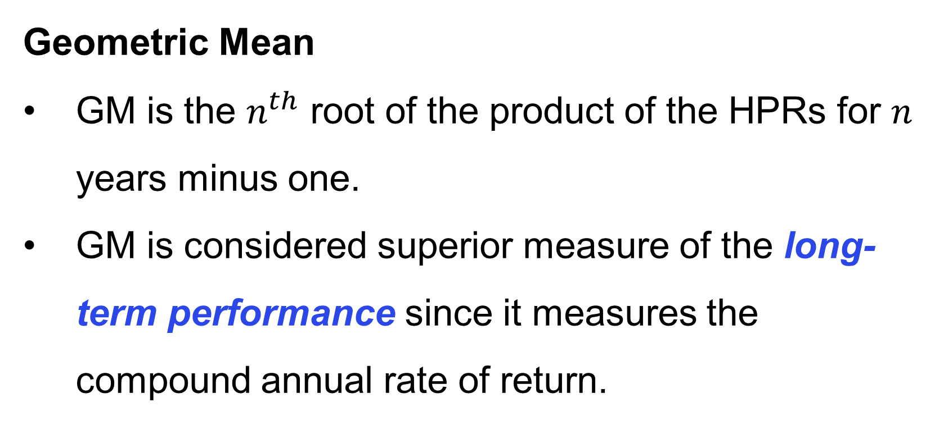
Mean Historical Rates of Return – Individual Investment
Arithmetic Mean (AM) | Geometric Mean (GM)
$$AM=\frac{\sum{HPY}}{n}$$ | $GM={\left(\prod{HPR}\right)}^{1/n}−$1
Arithmetic Mean (AM)
AM is the sum of annual HPYs divided by the number of years.
AM is best used as an expected rate of return for an individual year.
It is biased upward, if used to measure an asset’s long-term performance.
Geometric Mean
GM is the $n^{th}$ root of the product of the HPRs for $n$ years minus one.
GM is considered superior measure of the long-term performance since it measures the compound annual rate of return.
Which one do you prefer? Why?
Hint: Please solve Examples 6 & 7 in the next slides and discuss your opinions with your peers.

Slide 13
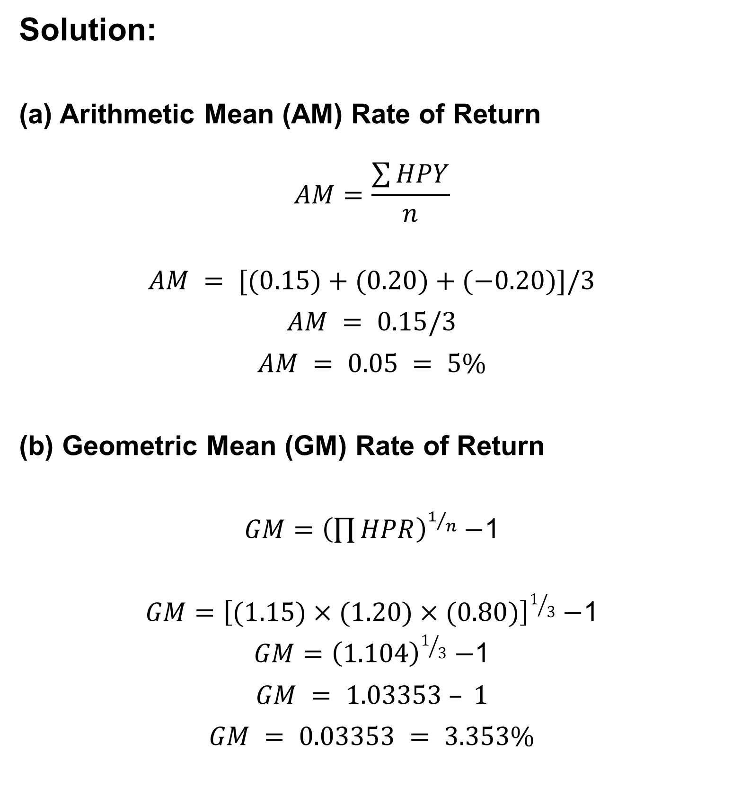
Example 6
Hand-on activities
Solution:
(a) Arithmetic Mean (AM) Rate of Return
$$AM=\frac{\sum{HPY}}{n}$$
$$AM = [(0.15)+(0.20)+(−0.20)]/3$$
$$AM = 0.15/3$$
$$AM = 0.05 = 5\%$$
(b) Geometric Mean (GM) Rate of Return
$GM={\left(\prod{HPR}\right)}^{1/n}−$1
$GM={\left[(1.15)×(1.20)×(0.80)\right]}^{1/3}−$1
$GM={\left(1.104\right)}^{1/3}−$1
$$GM = 1.03353 – 1$$
$$GM = 0.03353 = 3.353\%$$
For an investment with the following three years data, calculate the AM and GM rate of return on this investment.
Year | Beginning Value | Ending Value | HPR | HPY
1 | 100.0 | 115.0 | 1.15 | 0.15
2 | 115.0 | 138.0 | 1.20 | 0.20
3 | 138.0 | 110.4 | 0.80 | -0.20

Slide 14
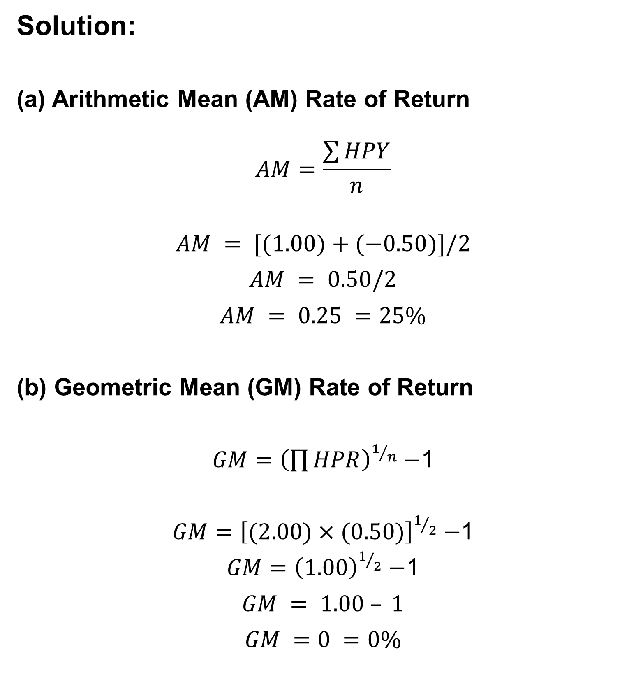
Example 7
Hand-on activities
Solution:
(a) Arithmetic Mean (AM) Rate of Return
$$AM=\frac{\sum{HPY}}{n}$$
$$AM = [(1.00)+(−0.50)]/2$$
$$AM = 0.50/2$$
$$AM = 0.25 =25\%$$
(b) Geometric Mean (GM) Rate of Return
$GM={\left(\prod{HPR}\right)}^{1/n}−$1
$GM={\left[(2.00)×(0.50)\right]}^{1/2}−$1
$GM={\left(1.00\right)}^{1/2}−$1
$$GM = 1.00 – 1$$
$$GM =0 =0\%$$
A security that increases in price from $50 to $100 during year 1 and drops back to $50 during year 2. What would be the AM and GM rate of returns?
Year | Beginning Value | Ending Value | HPR | HPY
1 | 50 | 100 | 2.00 | 1.00
2 | 100 | 50 | 0.50 | -0.50
AM is biased upward!!!

Slide 15
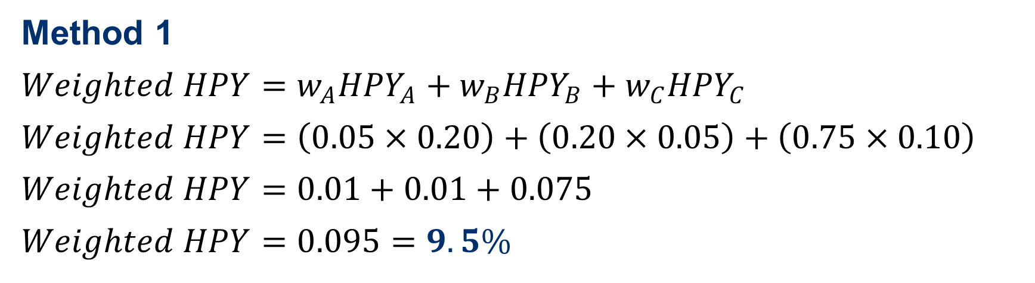
Mean Historical Rate of Return – Portfolio of Investments
Portfolio HPY: The weighted average of the HPYs for the individual investments in the portfolio, or the overall change in the value of the original portfolio.
The weights used in the computation are the relative beginning market values for each investment, which is often referred to as dollar-weighted or value-weighted mean rate of return.
Investment | Number of Shares | Beginning Price | Beginning Market Value | Ending Price | Ending Market Value | HPR | HPY | Market Weight* | Weighted HPY
A | 100,000 | $10 | $1,000,000 | $12 | $1,200,000 | 1.20 | 20% | 0.05 | 0.01
B | 200,000 | 20 | 4,000,000 | 21 | 4,200,000 | 1.05 | 5 | 0.20 | 0.01
C | 500,000 | 30 | 15,000,000 | 33 | 16,500,000 | 1.10 | 10 | 0.75 | 0.075
Total |  |  | $20,000,000 |  | $21,900,000 |  |  |  | 0.095
*Weights are based on beginning values
Method 1
$$Weighted HPY=w_{A}{HPY}_{A}+w_{B}{HPY}_{B}+w_{C}{HPY}_{C}$$
$$Weighted HPY=\left(0.05×0.20\right)+\left(0.20×0.05\right)+\left(0.75×0.10\right)$$
$$Weighted HPY=0.01+0.01+0.075$$
$$Weighted HPY=0.095=9.5\%$$
Method 2
$$HPR=\frac{Ending Value of Investment}{Beginning Value of Investment}=\frac{21,900,000}{20,000,000}=1.095$$
$$HPY=HPR −1=1.095 −1=0.095=9.5\%$$

Slide 16
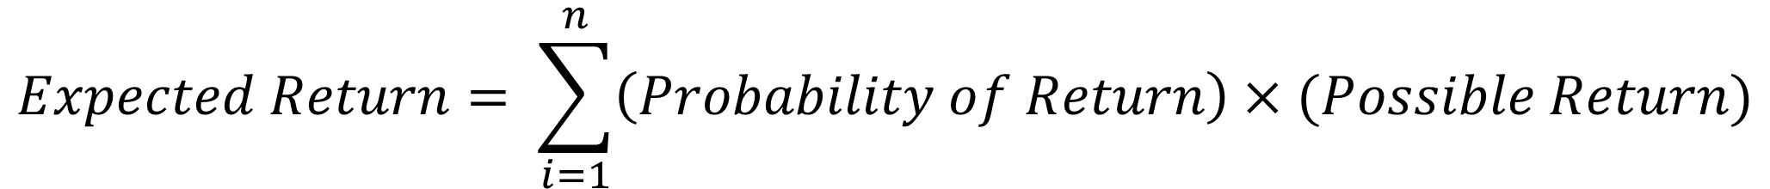
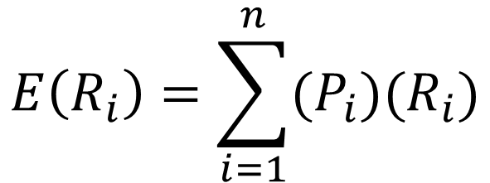
Expected Rates of Return
Year | Realized Historical Rates of Return
1 | 0.10
2 | 0.12
3 | 0.13
4 | 0.16
5 | 0.10
6 | 0.12
7 | 0.13
8 | 0.12
9 | 0.12
10 | 0.13
Possible Rates of Return | Probability
0.10 | 2/10 = 0.20
0.12 | 4/10 = 0.40
0.13 | 3/10 = 0.30
0.16 | 1/10 = 0.10
Total: | 1.00
Realized historical rates of return vs. expected return on a future risky investment.
Risk refers to the uncertainty of the future outcomes of an investment
There are many possible returns/outcomes from an investment due to the uncertainty
Probability is the likelihood of an outcome
The sum of the probabilities = 1.00
$$Expected Return= \sum_{i=1}^{n}{\left(Probability of Return\right)×(Possible Return)}$$
$E\left(R_{i}\right)=[\left(P_{1}R_{1}\right)+\left(P_{2}R_{2}\right)+\left(P_{3}R_{3}\right)+…+\left(P_{n}R_{n}\right)$]
$$E\left(R_{i}\right)=\sum_{i=1}^{n}{(P_{i})(R_{i})}$$

Slide 17
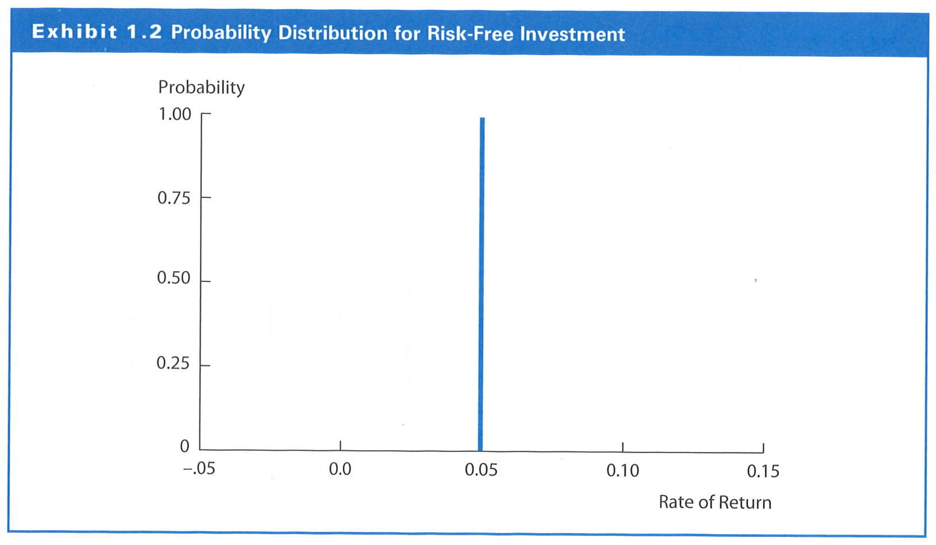
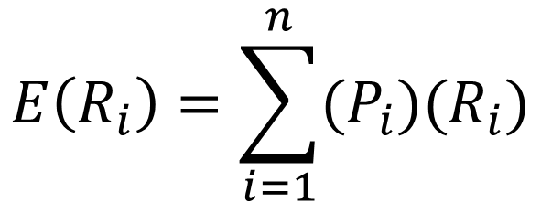
Example 1: Expected Return for Risk-Free Investment
$$E\left(R_{i}\right)=\sum_{i=1}^{n}{(P_{i})(R_{i})}$$
$$E\left(R_{i}\right)=\left(P_{i}\right)\left(R_{i}\right)=\left(1.00\right)\left(0.05\right)=0.05=5\%$$

Slide 18
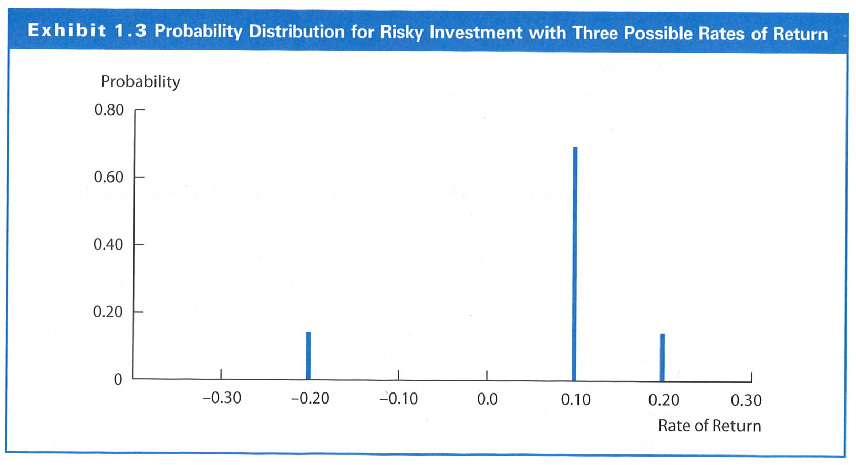
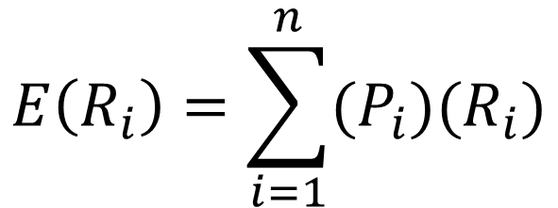
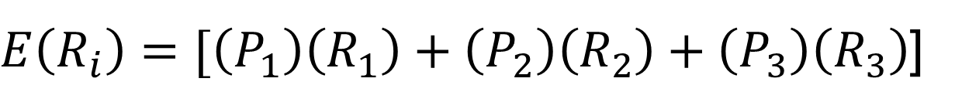
Example 2: Expected Return for Risky Investment with Three Possible Rates of Returns
Economic Conditions | Probability | Rate of Returns
Strong economy, no inflation | 0.15 | 0.20
Weak economy, above-average inflation | 0.15 | -0.20
No major change in economy | 0.70 | 0.10
$$E\left(R_{i}\right)=\sum_{i=1}^{n}{(P_{i})(R_{i})}$$
$E\left(R_{i}\right)=[\left(P_{1}\right)\left(R_{1}\right)+\left(P_{2}\right)\left(R_{2}\right)+\left(P_{3}\right)\left(R_{3}\right)$]
$E\left(R_{i}\right)=[\left(0.15\right)\left(0.20\right)+\left(0.15\right)\left(−0.20\right)+\left(0.70\right)\left(0.10\right)$]
$$E\left(R_{i}\right)=0.03−0.03+0.07=0.07=7\%$$

Slide 19
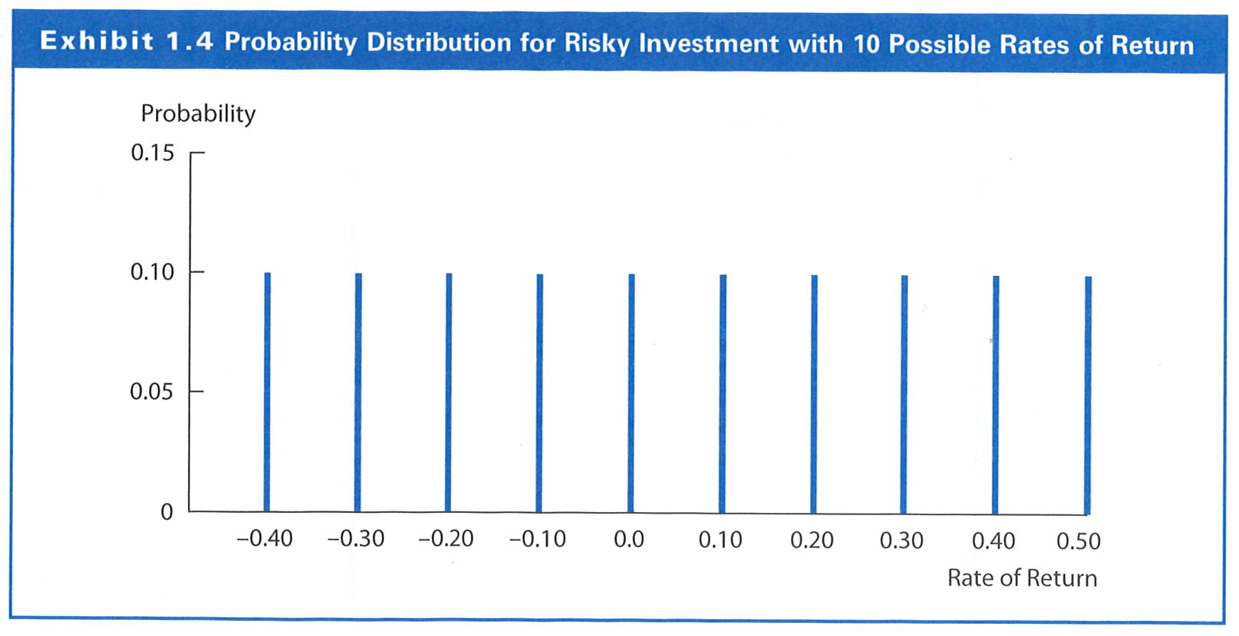
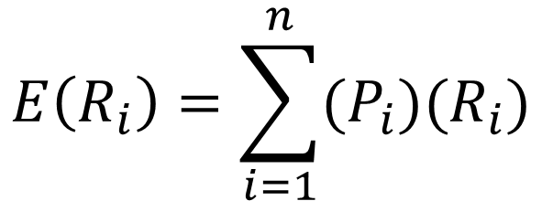
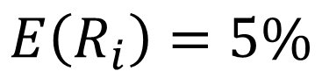
Example 3: Expected Return for Risky Investment with Ten Possible Rates of Returns
$$E\left(R_{i}\right)=\sum_{i=1}^{n}{(P_{i})(R_{i})}$$
$$E\left(R_{i}\right)=5\%$$

Slide 20
Risk of Expected Rates of Return
Risk refers to the uncertainty of investment. The risk of expected return reflects the degree of uncertainty that actual return will be different from the expect return.

Slide 21
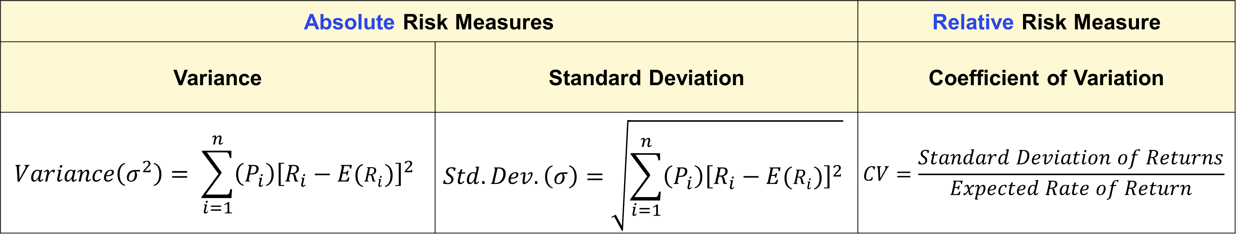
Risk Measures for Expected Rates of Return
Absolute Risk Measures |  | Relative Risk Measure
Variance | Standard Deviation | Coefficient of Variation
$$Variance\left(σ^{2}\right)= \sum_{i=1}^{n}{\left(P_{i}\right){\left[R_{i}−E(R_{i})\right]}^{2}}$$ | $$Std.Dev.\left(σ\right)=\sqrt{\sum_{i=1}^{n}{\left(P_{i}\right){\left[R_{i}−E(R_{i})\right]}^{2}}}$$ | $$CV=\frac{Standard Deviation of Returns}{Expected Rate of Return}$$
Note: Larger variance, standard deviation and coefficient of variation indicate the greater risk of the investment.

Slide 22
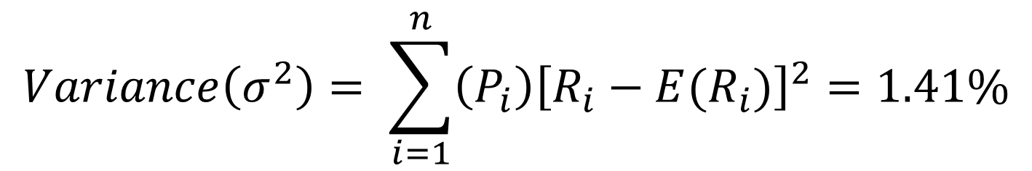
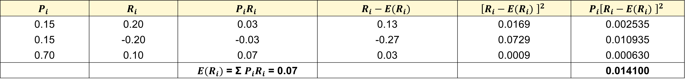
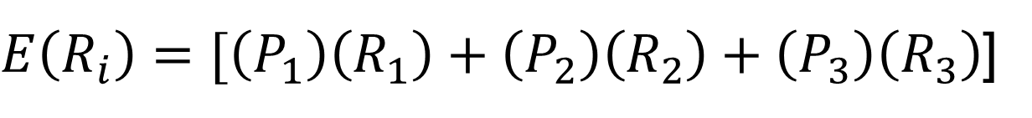
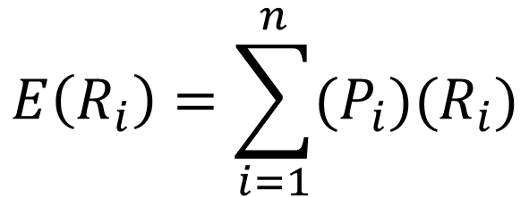
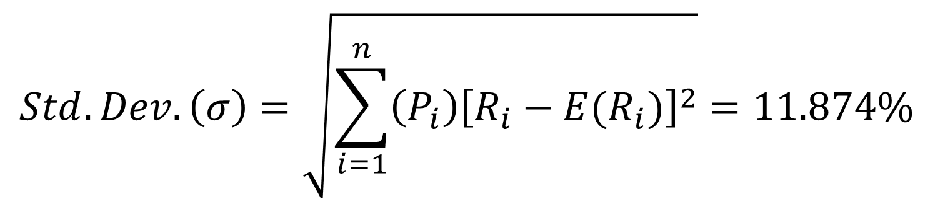
Example: Absolute Risk Measures (i.e. Variance and Standard Deviation)
$$P_{i}$$ | $$R_{i}$$ | $$P_{i}R_{i}$$ | $$R_{i}−E(R_{i})$$ | $${\left[R_{i}−E(R_{i}) \right]}^{2}$$ | $${P_{i}\left[R_{i}−E(R_{i}) \right]}^{2}$$
0.15 | 0.20 | 0.03 | 0.13 | 0.0169 | 0.002535
0.15 | -0.20 | -0.03 | -0.27 | 0.0729 | 0.010935
0.70 | 0.10 | 0.07 | 0.03 | 0.0009 | 0.000630
 |  | $E(R_{i})$ = Σ $P_{i}R_{i}$ = 0.07 |  |  | 0.014100
$$E\left(R_{i}\right)=\sum_{i=1}^{n}{(P_{i})(R_{i})}$$
$$Variance\left(σ^{2}\right)= \sum_{i=1}^{n}{\left(P_{i}\right){\left[R_{i}−E(R_{i})\right]}^{2}}=1.41\%$$
$E\left(R_{i}\right)=[\left(P_{1}\right)\left(R_{1}\right)+\left(P_{2}\right)\left(R_{2}\right)+\left(P_{3}\right)\left(R_{3}\right)$]
$$Std.Dev.\left(σ\right)=\sqrt{\sum_{i=1}^{n}{\left(P_{i}\right){\left[R_{i}−E(R_{i})\right]}^{2}}}=11.874\%$$
$E\left(R_{i}\right)=[\left(0.15\right)\left(0.20\right)+\left(0.15\right)\left(−0.20\right)+\left(0.70\right)\left(0.10\right)$]
$$E\left(R_{i}\right)=0.03−0.03+0.07=0.07=7\%$$

Slide 23
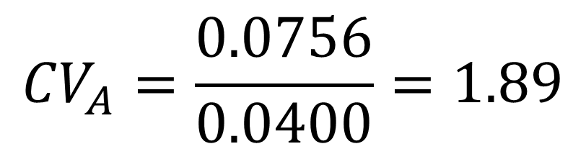
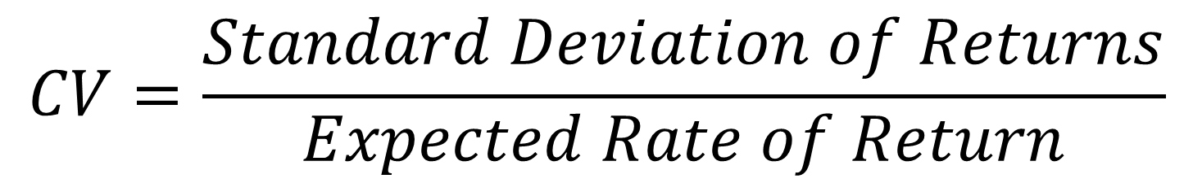
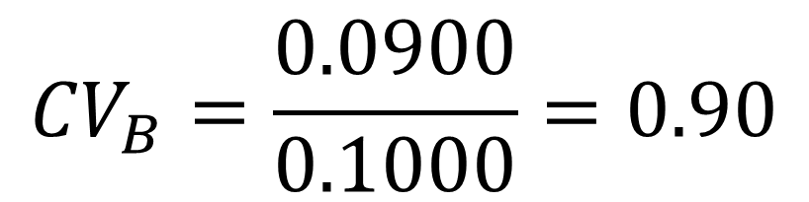
Example: Relative Risk Measures (Coefficient of Variation)
Investment A:
Standard Deviation = 0.0756
Expected Return = 0.0400
Investment B:
Standard Deviation = 0.0900
Expected Return = 0.1000
Which of the two investments has lower relative risk?
$$CV=\frac{Standard Deviation of Returns}{Expected Rate of Return}$$
$${CV}_{A}=\frac{0.0756}{0.0400}=1.89$$
$${CV}_{B}=\frac{0.0900}{0.1000}=0.90$$
Investment B has less relative variability or lower risk per unit of expected return (because it has a substantially higher E(R))
How would you explain these ratios in the simplest terms?

Slide 24
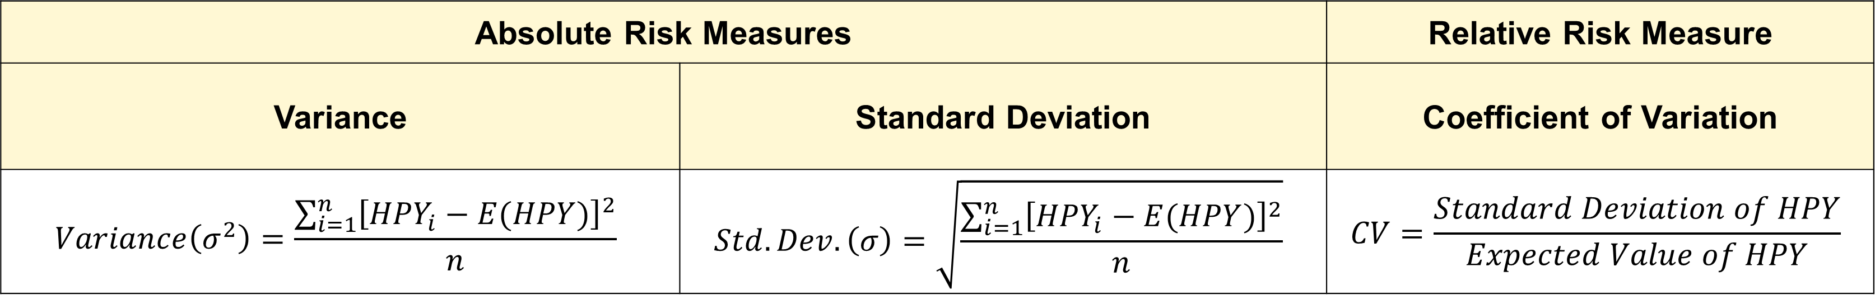
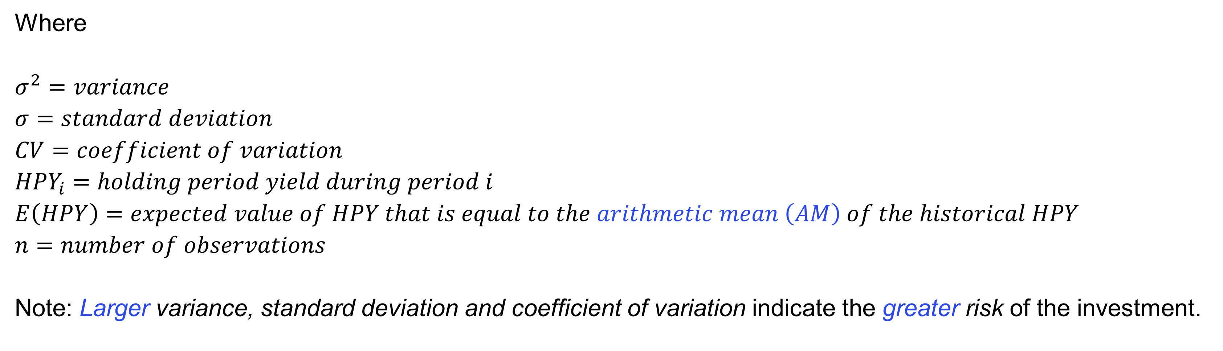
Risk Measures for Historical Rates of Return
Absolute Risk Measures |  | Relative Risk Measure
Variance | Standard Deviation | Coefficient of Variation
$$Variance\left(σ^{2}\right)=\frac{\sum_{i=1}^{n}{{\left[{HPY}_{i}−E(HPY)\right]}^{2}}}{n}$$ | $$Std.Dev.\left(σ\right)=\sqrt{\frac{\sum_{i=1}^{n}{{\left[{HPY}_{i}−E(HPY)\right]}^{2}}}{n}}$$ | $$CV=\frac{Standard Deviation of HPY}{Expected Value of HPY}$$
Where
$$σ^{2}=variance$$
$$σ=standard deviation$$
$$CV=coefficient of variation$$
$${HPY}_{i}=holding period yield during period i$$
$$E\left(HPY\right)=expected value of HPY that is equal to the arithmetic mean \left(AM\right) of the historical HPY$$
$$n=number of observations$$
Note: Larger variance, standard deviation and coefficient of variation indicate the greater risk of the investment.

Slide 25
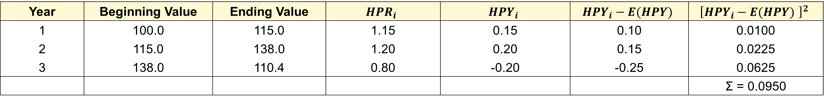
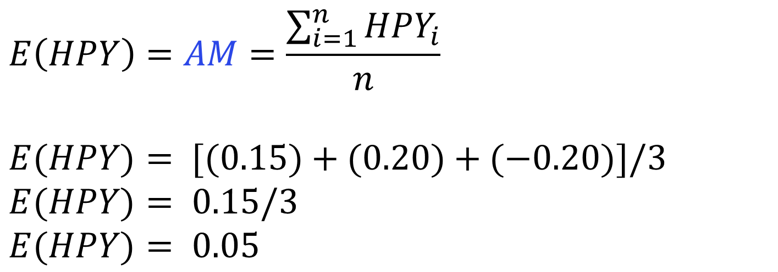
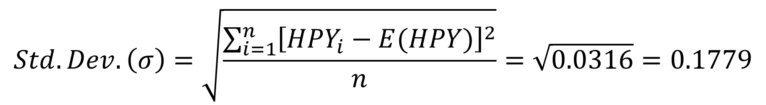
Example: Absolute Risk Measures (i.e. Variance and Standard Deviation)
For an investment with the following three years data, calculate the Variance and Standard Deviation of the HPY on this investment.
Year | Beginning Value | Ending Value | $${HPR}_{i}$$ | $${HPY}_{i}$$ | $${HPY}_{i}−E(HPY)$$ | $${\left[{HPY}_{i}−E(HPY) \right]}^{2}$$
1 | 100.0 | 115.0 | 1.15 | 0.15 | 0.10 | 0.0100
2 | 115.0 | 138.0 | 1.20 | 0.20 | 0.15 | 0.0225
3 | 138.0 | 110.4 | 0.80 | -0.20 | -0.25 | 0.0625
 |  |  |  |  |  | Σ = 0.0950
$$E\left(HPY\right)=AM=\frac{\sum_{i=1}^{n}{{HPY}_{i}}}{n}$$
$$E(HPY)= [(0.15)+(0.20)+(−0.20)]/3$$
$$E(HPY)= 0.15/3$$
$$E(HPY)= 0.05$$
$$Variance\left(σ^{2}\right)= \frac{\sum_{i=1}^{n}{{\left[{HPY}_{i}−E(HPY)\right]}^{2}}}{n}=\frac{0.0950}{3}=0.0316$$
$$Std.Dev.\left(σ\right)=\sqrt{\frac{\sum_{i=1}^{n}{{\left[{HPY}_{i}−E(HPY)\right]}^{2}}}{n}}=\sqrt{0.0316}=0.1779$$

Slide 26
Determinants of Required Rate of Return
3

Slide 27
Required Rates of Return
Components of Required Rates of Return
Time value (or RRFR)
Expected inflation
Risk premiums
The summation of the three components is called the required rate of return (RRR):
RRR = RRFR
+ Expected Inflation Rate NRFR
+ Risk Premium
Determinants of Required Rates of Return
Factors that influence Real Risk Free Rate (RRFR)
Time preference for income consumption
Investment opportunities in the economy (i.e. the long-run real growth rate)
Factors that Influence Nominal Risk Free Rate (NRFR)
Capital market conditions (i.e. the relative ease or tightness in the capital market)
Expected inflation rate
Risk Premium
Either as a function of Fundamental Risk Factors
Or as a function of asset’s Systematic Market Risk (i.e. Beta)
Stop and Think:
Please evaluate how easy estimating RRoR is based on the scale from 1 to 10 (10 is very easy)

Slide 28
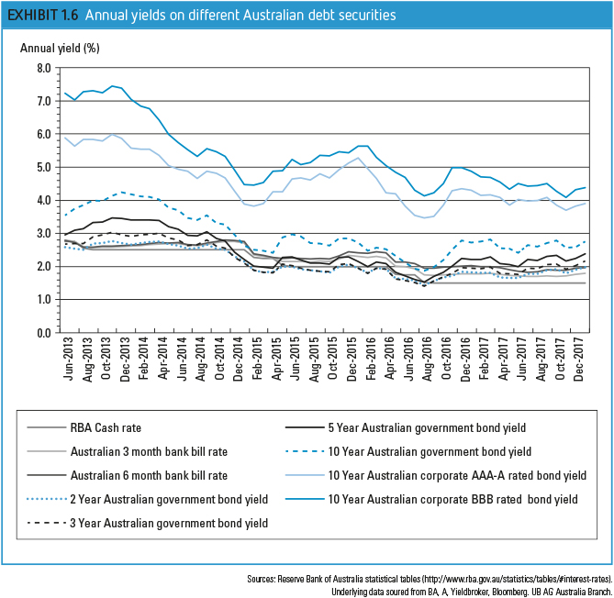
EXHIBIT 1.6
Estimating the RRoR is complicated:
Wide range of rates available for different investments at any time
Rates of return on specific assets change over time
The spread (difference between the rates on different assets changes over time

Slide 29
The Real Risk-Free Rate (RRFR)
The real risk-free rate (RRFR) is the rate of return that assumes no inflation and no uncertainty about future cash flows.
Factors influencing the RRFR
Time preference for income consumption
Investment opportunities in the economy

Slide 30
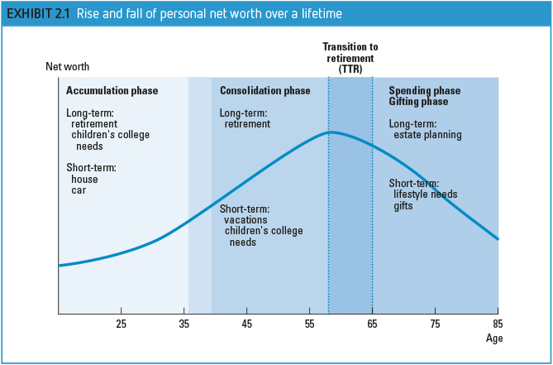
End-chapter Q3
Hand-on activities
Time preference for income consumption
The time preferences for income consumption vary among individuals.
Divide a person’s life from ages 20 to 70 into 10-year segments and discuss the likely saving or borrowing patterns during each period.

Slide 31
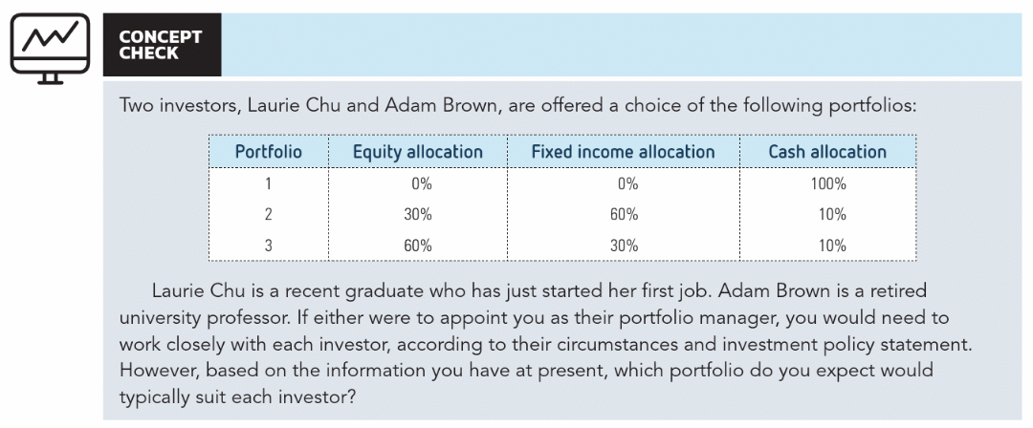
Hand-on activities

Slide 32
The Real Risk-Free Rate (RRFR)
The real risk-free rate (RRFR) is the rate of return that assumes no inflation and no uncertainty about future cash flows.
Factors influencing the RRFR
Time preference for income consumption
Investment opportunities in the economy
Investment opportunities
Investment opportunities available are determined by the long-run real growth rate of the economy
Thus, a positive relationship exists between the real growth rate in the economy and the RRFR
https://www.stats.govt.nz/topics/gross-domestic-product

Slide 33
The Nominal Risk-Free Return (NRFR)
The nominal risk-free return (NRFR) is the rate of return that assumes capital market conditions and expected rate of inflation in addition to the real rate of interest.
Factors influencing the NRFR
Capital Market Conditions
Expected Rate of Inflation
Capital Market Conditions
The temporary disequilibrium in the supply and demand of capital in the economy causes the short-run change in the relative ease or tightness in the capital market.

Slide 34
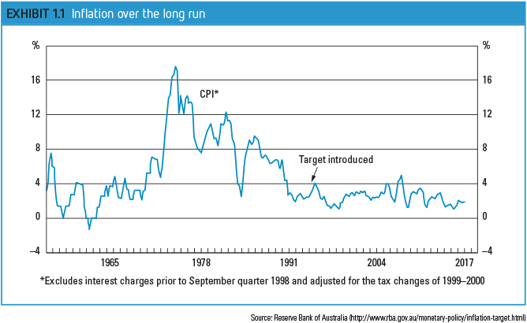
EXHIBIT 1.1

Slide 35
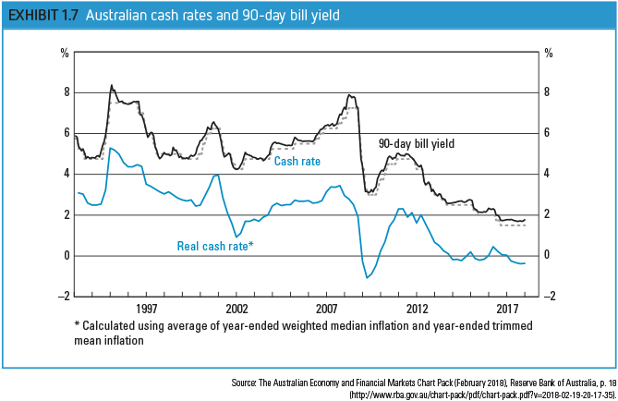
EXHIBIT 1.7

Slide 36
The Nominal Risk-Free Return (NRFR)
The nominal risk-free return (NRFR) is the rate of return that assumes capital market conditions and expected rate of inflation in addition to the real rate of interest.
Factors influencing the NRFR
Capital Market Conditions
Expected Rate of Inflation
Capital Market Conditions
The temporary disequilibrium in the supply and demand of capital in the economy causes the short-run change in the relative ease or tightness in the capital market.
Expected Rate of Inflation
Investors require the rate of return to include compensation for the expected rate of inflation.
The nominal risk-free return can be measured as;
This equation can be re-written for real risk-free return

Slide 37
Risk Premium – Fundamental Risk Factors
Risk Premium (RP)
A risk premium is the return in excess of the nominal risk-free rate of return an investment is expected to yield.
A risk premium is a form of compensation for investors to tolerate the extra risk, compared to that of risk-free investment.
A risk-free investment is one for which the investor is certain of the amount and timing of the expected return.
Risk premium varies from asset to asset and is responsible for differences in rates of return between assets at a certain point in time.
Risk premium represents a composite of all uncertainty. Following are some fundamental sources of uncertainty:
Business risk – uncertainty of income flows caused by the nature of a firm’s business.
Financial risk – uncertainty caused by the use of debt financing
Liquidity risk - the inability to buy or sell an asset quickly with little price change.
Exchange rate risk - the uncertainty of returns on securities acquired in a foreign currency.
Country risk – also called political risk. It is the uncertainty due to the possibility of major political or economic change in the country where an investment has been made.
$$Risk Premium= f(Business Risk, Financial Risk, Liquidity Risk, Exchange Rate Risk, Country Risk)$$

Slide 38
Example - Financial risk
Source: Ho and Gan (2021)

Slide 39
Example – Country Risk
Source: Ho and Gan (2021)

Slide 40
Other sources of uncertainty?
Source: Ho and Gan (2021)

Slide 41
Pandemic Uncertainty
Source: Ho and Gan (2021)

Slide 42
Identify Risks (10 mins)
Hand-on activities
Read 150 Risks in Finance
Identify potential risks in managing an investment portfolio that includes securities/firms from the Construction Industry

Slide 43
Risk Premium and Portfolio Theory
From a portfolio theory perspective, the relevant risk measure for an individual asset is its co-movement with the market portfolio
Systematic risk relates the variance of the investment to the variance of the market
Unsystematic risk is due to the asset’s unique features
The risk premium for an individual earning asset is a function of the asset’s systematic risk with the aggregate market portfolio of risky assets
The measure of an asset’s systematic risk is referred to as its beta:

Slide 44
Relationship between Risk and Return
4

Slide 45
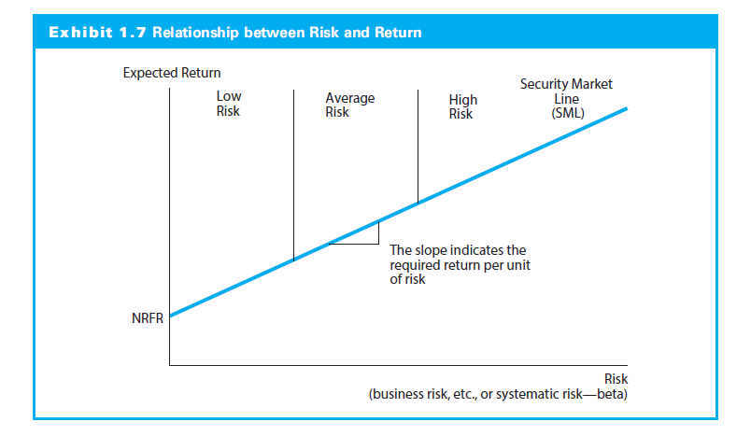
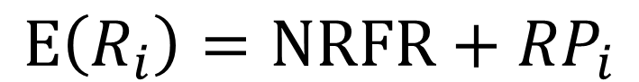
Relationship between Risk and Return
$$E\left(R_{i}\right)=NRFR+{RP}_{i}$$
The line that reflects the combination of risk and return available on alternative investments is referred to the security market line (SML).
Investors would select investments that are consistent with their risk preferences; some would consider only low-risk investments whereas others welcome high-risk investments.

Slide 46
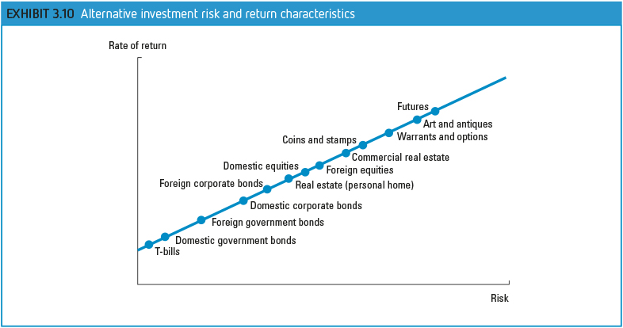

Slide 47
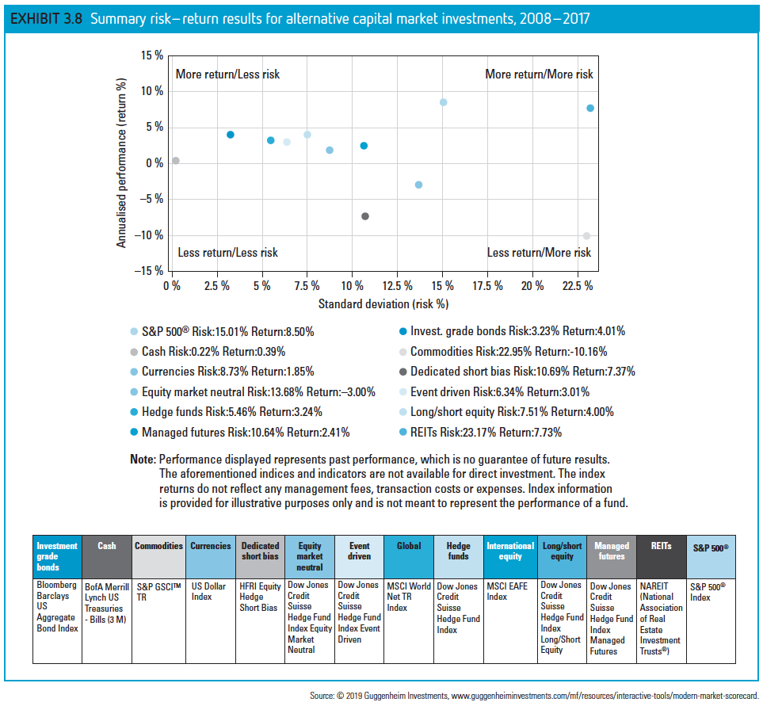
EXHIBIT 3.8

Slide 48
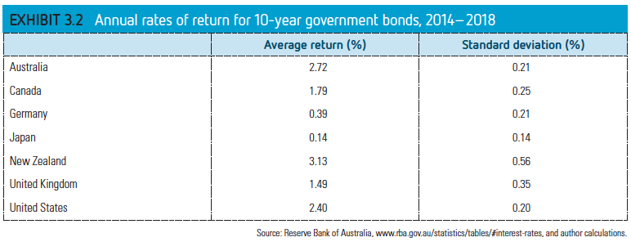
EXHIBIT 3.2

Slide 49
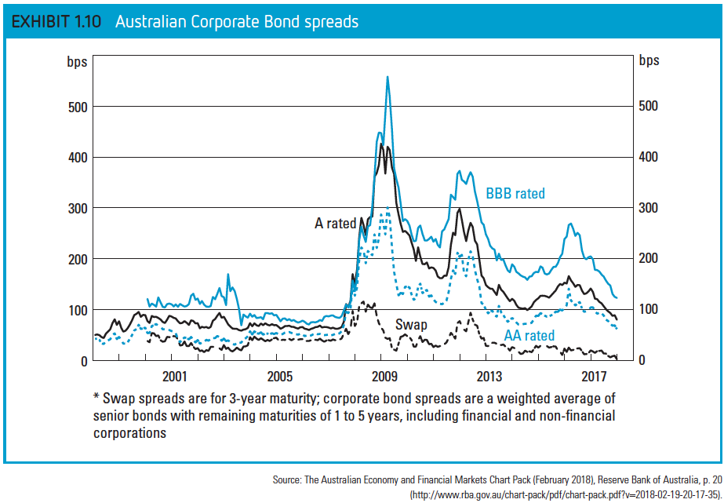
EXHIBIT 1.9

Slide 50
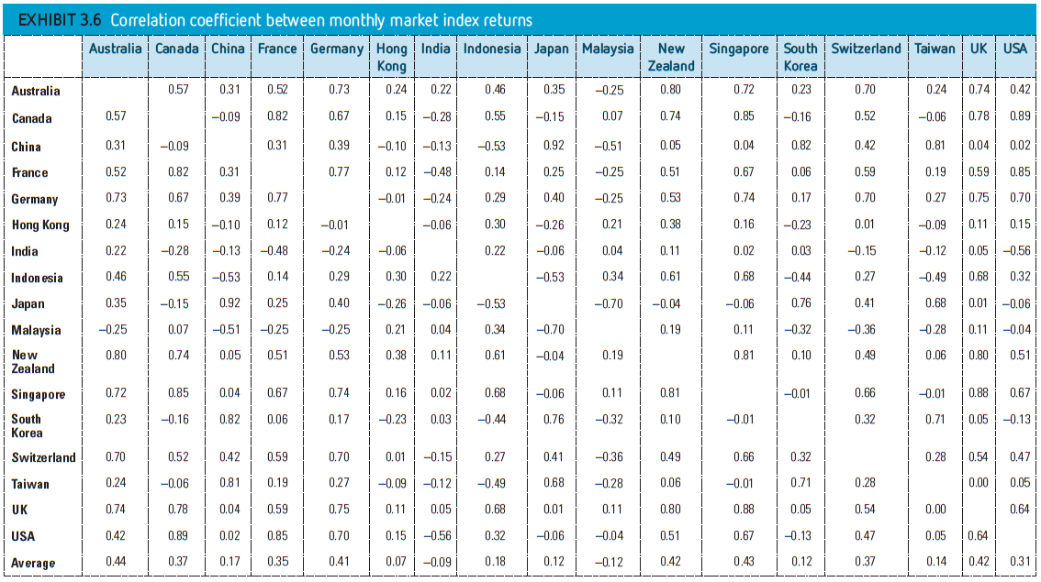
EXHIBIT 3.6

Slide 51
GLOBAL EQUITY PORTFOLIO RISK
Low positive correlation (Exhibit 3.6)
While the return correlations between Australia and New Zealand (0.80) and the UK (0.74) are high and positive the average across all markets is only moderately positive at 0.44. Similarly, while the US market’s return correlations with Canada and the larger European markets are high and positive, the average across all markets is also relatively low at 0.31.
Domestic diversification (Exhibit 3.7)
As you increase the number of randomly selected securities in a portfolio, the standard deviation will decline due to the benefits of diversification within your own country. This is referred to as domestic diversification

Slide 52
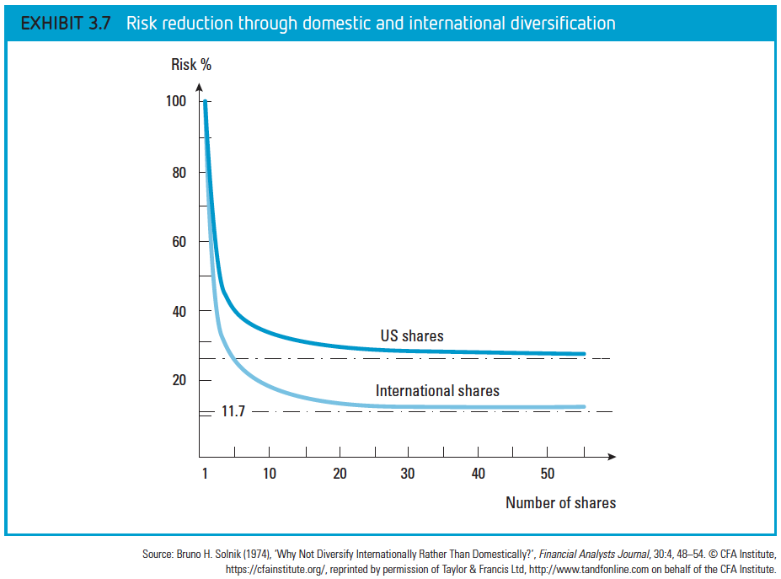
EXHIBIT 3.7

Slide 53
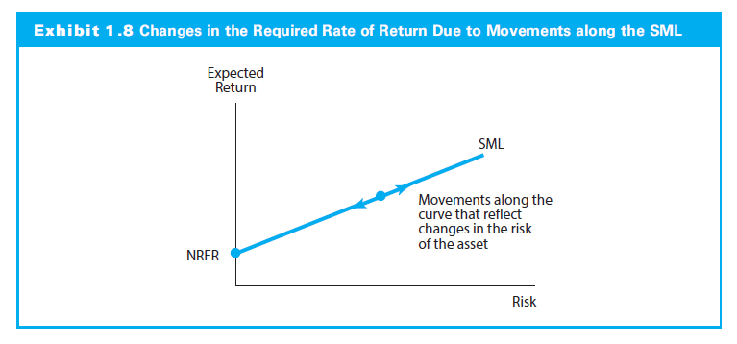


Changes in the SML
An individual investment can change positions on the SML because of the changes in the perceived risk of the investment.
The slope of the SML can change because of a change in the attitudes of investors towards risk (i.e. investor can change the returns they require per unit risk.)
The SML can experience a parallel shift due to a change in the RRFR or the expected rate of inflation (i.e. anything that can change NRFR).

Slide 54
End of Chapter 1

